Slide 1

STREAM EDITOR SOFTWARE

Slide 2

WELCOME!
TEAM MEMBERS
S . Preethi
K . Bhargavi
V . Kanchana
S . Reddy Sudha
P . Mounika
Photo credit: padrinan via Pixabay (Creative Commons Zero license)

Slide 3
PROJECT DESCRIPTI0N
SES accepts input file and pattern_spes file.
SES shall search and replace all “search strings” with corresponding “replace strings”.
If any text is repeated both input file and pattern_file then the text is replaced with another “string” or “number” or “symbol”.
Pattern_specs file contents should support mentioning whether the search/replace is case sensitive or insensitive.
SES shall load the file content into memory , and then do all processing in memory.final result in written to output file at once.

Slide 4
OBJECTIVE
As per the requirement we need to consider 1)Case sensitive
2) In sensitive in the pattern_spes file.
Here ,we consider 3 Different inputs
A Lower case to character Strings.
An Uppercase String words.
And lines as Strings.
In the pattern_spes file the replace String for corresponding to Char String, String Word and Lines replace accordingly.
In the lines of Strings first we check for Case sensitive of String if YES we replaced with the corresponding replace String in the pattern_spes file, if not we check for insensitive and replace accordingly.

Slide 5



TOOLS USED
Valgrind is a tool for finding memory access errors to heap memory (memory that is dynamically allocated with new or malloc) in C and C++ programs. Memory access errors are the most difficult bugs to find and to fix.
GDB stands for GNU Project Debugger and is a powerful debugging tool for C(along with other languages like C++). It helps you to poke around inside your C programs while they are executing and also allows you to see what exactly happens when your program crashes.
Splint, short for Secure Programming Lint, is a programming tool for statically checking C programs for security vulnerabilities and coding mistakes.

Slide 6
MAKEFILE:
Makefile is a set of commands (similar to terminal commands) with variable names and targets to create object file and to remove them. In a single make file we can create multiple targets to compile and to remove object, binary files. You can compile your project (program) any number of times by using Makefile..
To transform dependency files to target results via multiple arbitrary commands
To detect changes made to an image file
To convert between different file formats via an automatic system that copies the final file to different emails targeting multiple users through a custom content management system

Slide 7



PHASES OF PROJECT
Makefile
GDB
Valgrind
Splint
Test Cases
Results

Slide 8



WORK DONE
The code is written in C language by using the concept of Makefile .
By using valgrind , GDB and Splint tools we can detect the errors and memory leakage.
Here , we gave inputs as Char String, String Word and Lines .

Slide 9
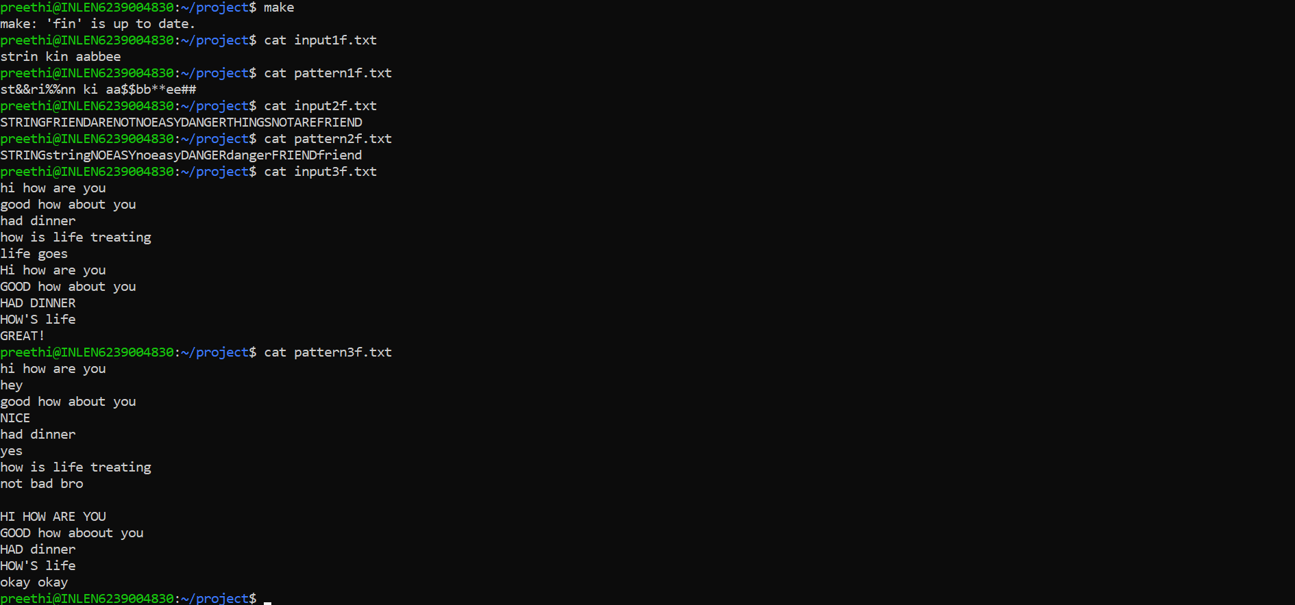
INPUT SCREENSHOTS

Slide 10
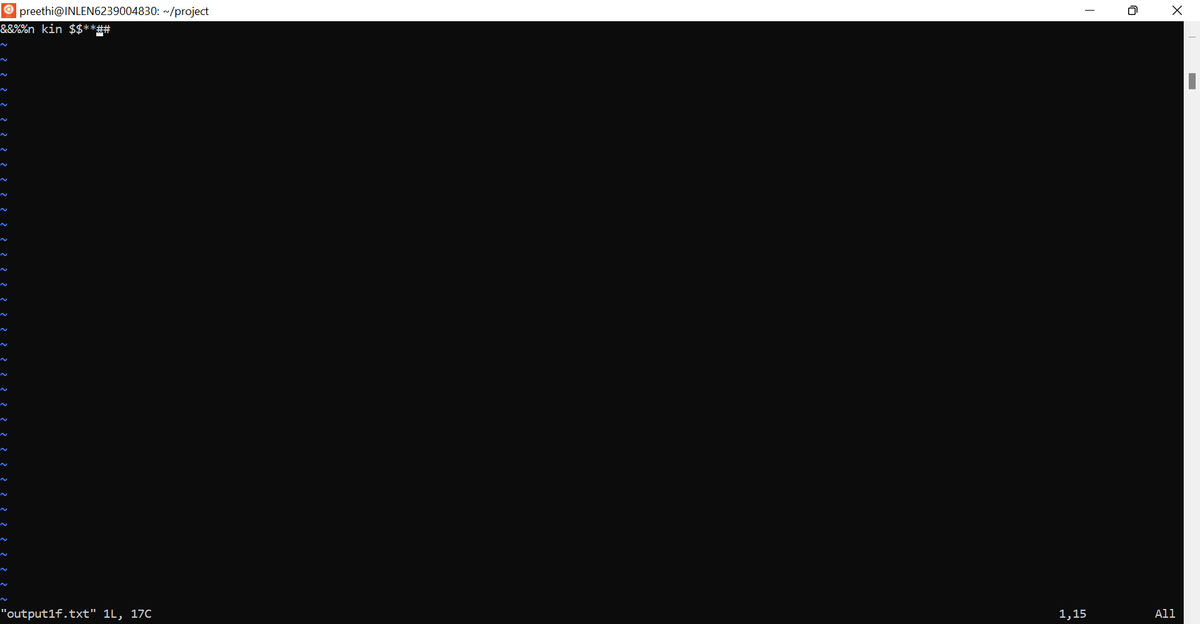
OUTPUT SCREEN SHOTS

Slide 11
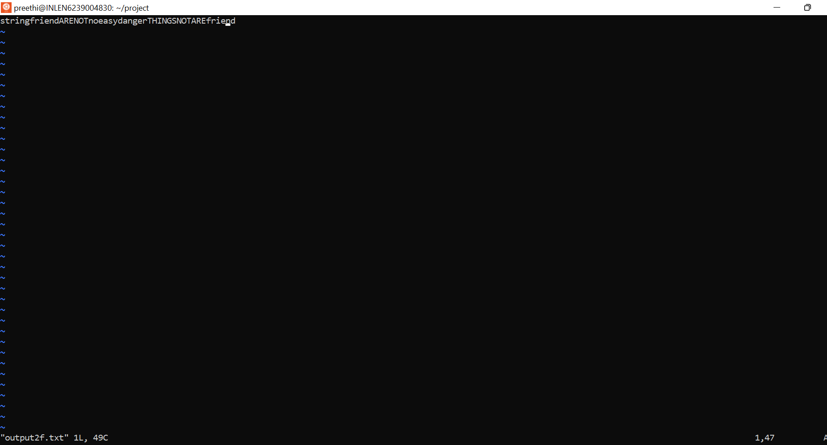

Slide 12
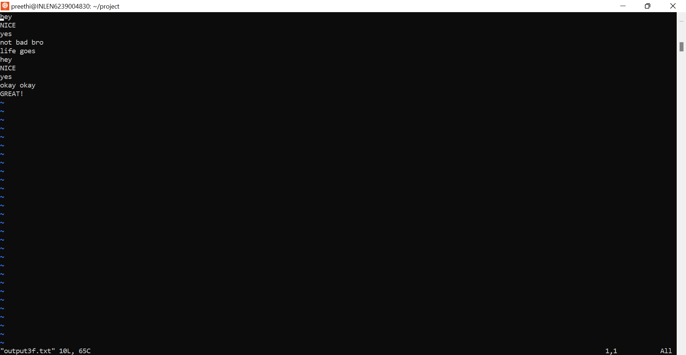

Slide 13


